Slide 1
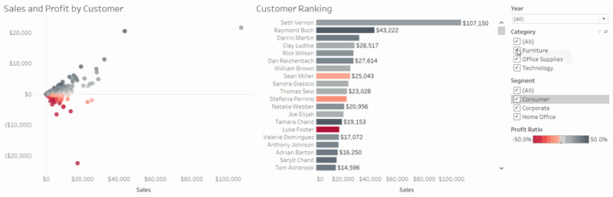
Intro to Tableau
Kellie Clinton (KeC)

Slide 2

Agenda
Overview
Preparing Data
Exploring Data
Coding and Applications
Key Takeaways

Slide 3
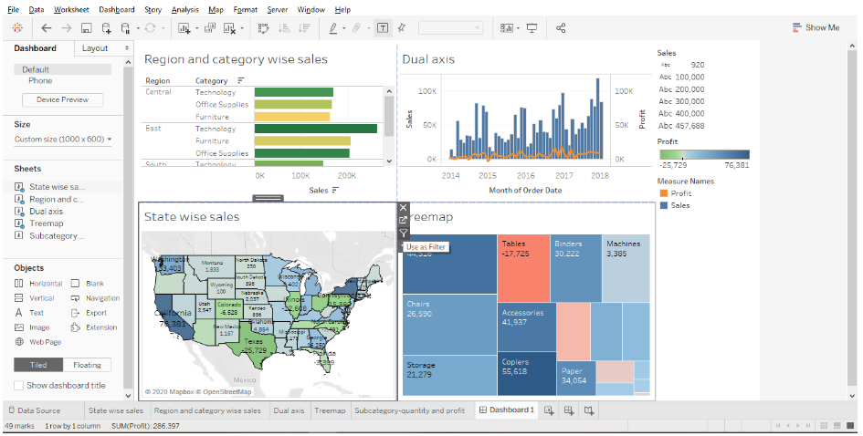
What is Tableau
Business intelligence and data visualization platform
Creates interactive charts, graphs, and dashboards
Shift the conversation from "What does this data mean?" to "What should we do next?"
Team Collaboration
Access: Enterprise Tableau license or free trial

Slide 4
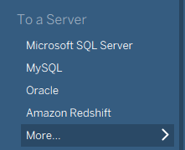
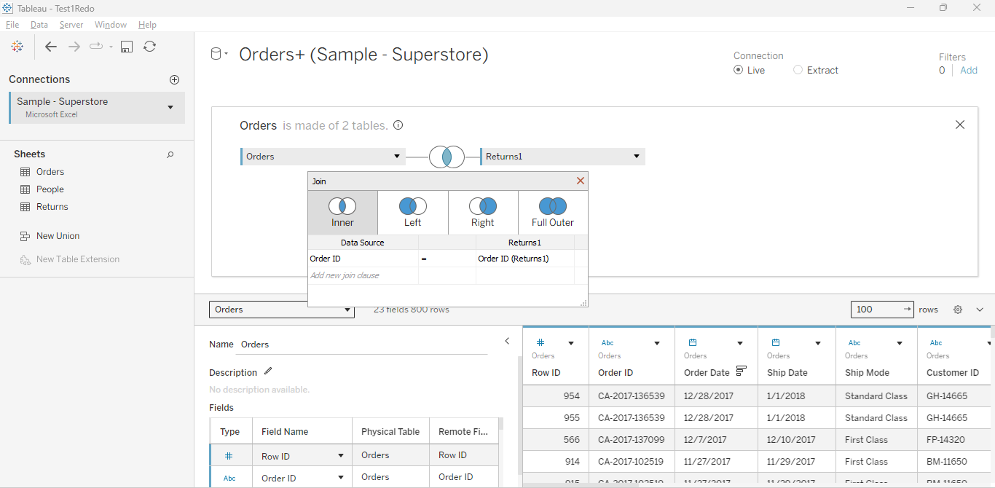
Preparing Data: Superstore
Trusted connections across enterprise data sources
Built-in SQL database connectors including PostgreSQL, MySQL, Oracle, and Snowflake
Streamline ETL by cleansing data anomalies and standardizing formatting
Automate data refreshes

Slide 5
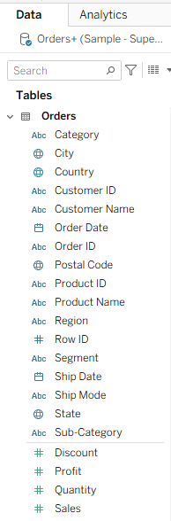
Exploring Data
Dimensions describe categories or groupings
Measures are quantitative values that can be analyzed
Placing dimensions and measures into the worksheet determines how Tableau groups and summarizes the data

Slide 6
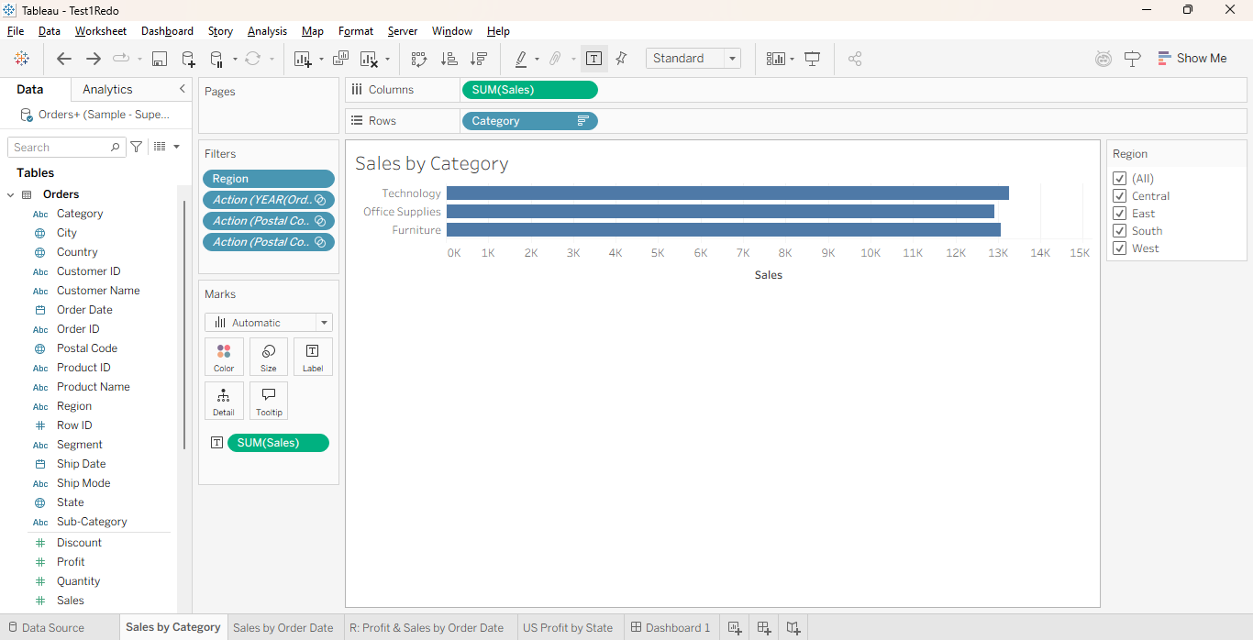
Visual: Sales by Category
Which product category generates the most sales?
Value: Helps the business understand where its sales are concentrated
Notes:
Color: Changes hue or applies diverging/sequential gradients based on a dimension or measure.
Size: Scales the thickness, length, or radius of the mark.
Label: Adds text values directly onto or near the mark.
Detail: Adds dimensions to increase the number of individual marks in the view without changing color/size.
Tooltip: Controls what pop-up text appears when you hover over a mark.

Slide 7
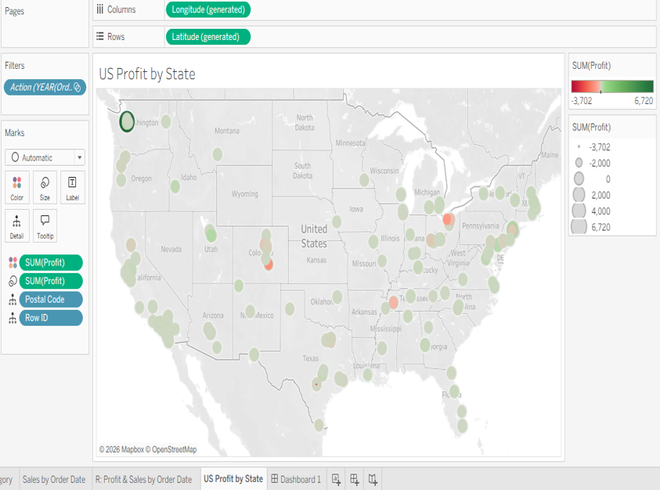
US Profit by Zip Code
How does profitability vary across geographic areas?
Value: Helps the business identify geographic differences in profitability and areas that may need further investigation

Slide 8
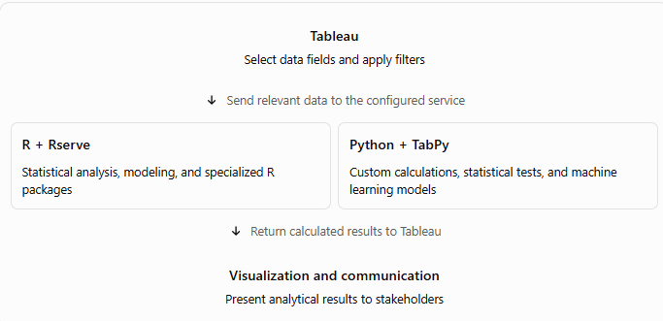
Coding and Applications: R & Python Integration

Slide 9
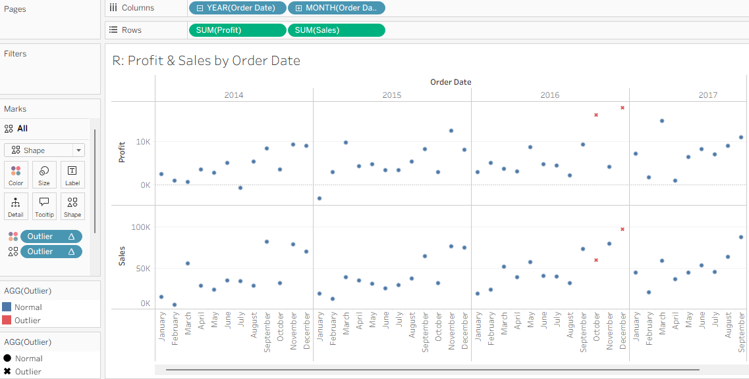
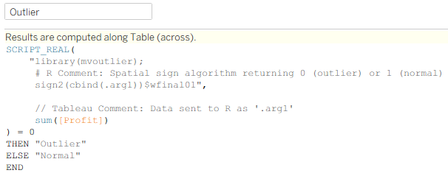
R: Profit & Sales by Order Date
Does profit follow the same pattern as sales?
Value: Helps identify periods that may need further investigation into discounts, costs, or product mix
Notes:
Tableau sends aggregated profit data to R.
R uses a spatial-sign-based method to flag potential outliers.
Tableau displays the result as “Outlier” or “Normal.”

Slide 10
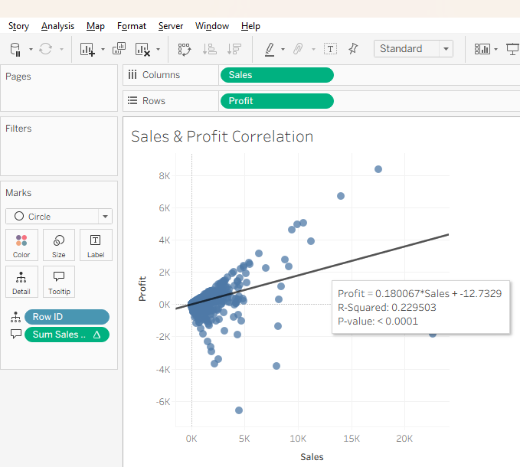
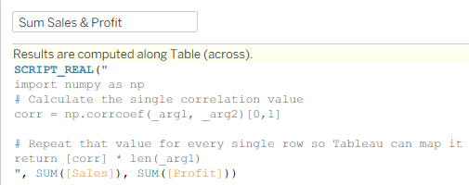
Python: Measuring the Relationship Between Sales and Profit
Are sales and profit linearly associated?
Value: Sales alone may not fully describe financial performance
Notes:
Sales increase, the points fan out wildly in every direction—some massive sales have huge profits, while others have massive losses

Slide 11
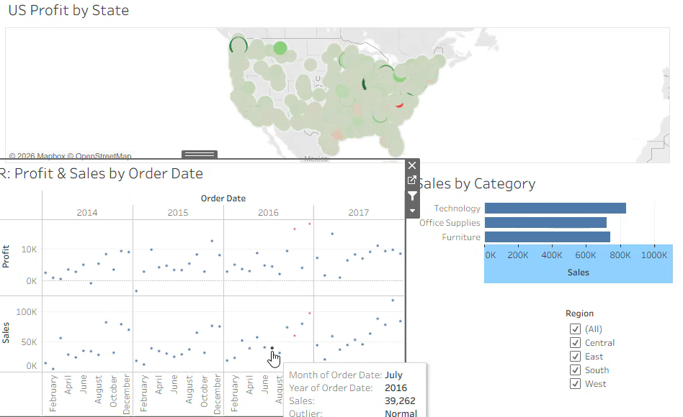
Bringing the Analysis Together: Dashboard
Bringing multiple views together helps compare trends without switching between separate reports
Stakeholders can use the dashboard to explore the available data themselves

Slide 12
When to Use Tableau
Strengths:
Natively connects to enterprise databases, warehouses, and servers
Rapid interactive data exploration
Cross-team collaboration
Impactful executive storytelling
Limitations:
Cannot perform heavy machine learning, advanced NLP, or custom statistical architectures
Inefficient for processing unstructured text (e.g., emails), running massive loop iterations
Version-control and code-review workflow is more limited than a conventional Git-based workflow
Notes:
NLP – Natural Language Processing

Slide 13
Key Takeaways
Self-service dashboards that non-technical clients and executive stakeholders can easily understand and trust
Visual exploration, not heavy modeling
Tool Integration combines SQL for data extraction, Python/R for advanced math, and Tableau for final visuals

Slide 14
Thank you!
Questions?

